Slide 1
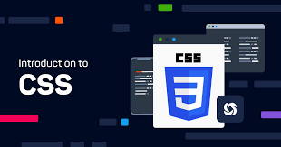

WELCOME TO WEB DESIGNING
CSS > THE HERO OF DESIGNS

Slide 2

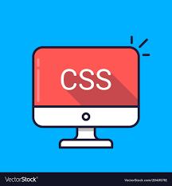
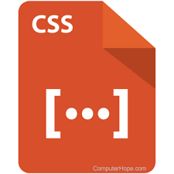
Topics to be Covered:
Overview
What is CSS?
Why to use CSS?
How to apply CSS?
Difference between External and Internal CSS?
What is Padding and Margin in CSS?
What is Box Model?
Explain Selectors in CSS?
Difference between class selector and id selector?
What is Universal selector?
What are Positions in CSS?
Difference between Relative and Absolute Position ?
What is z-index?
How to display element at center of webpage in CSS?
Explain Dimensions in CSS?

Slide 3
WHAT IS CSS?
ANY IDEA ????

Slide 4
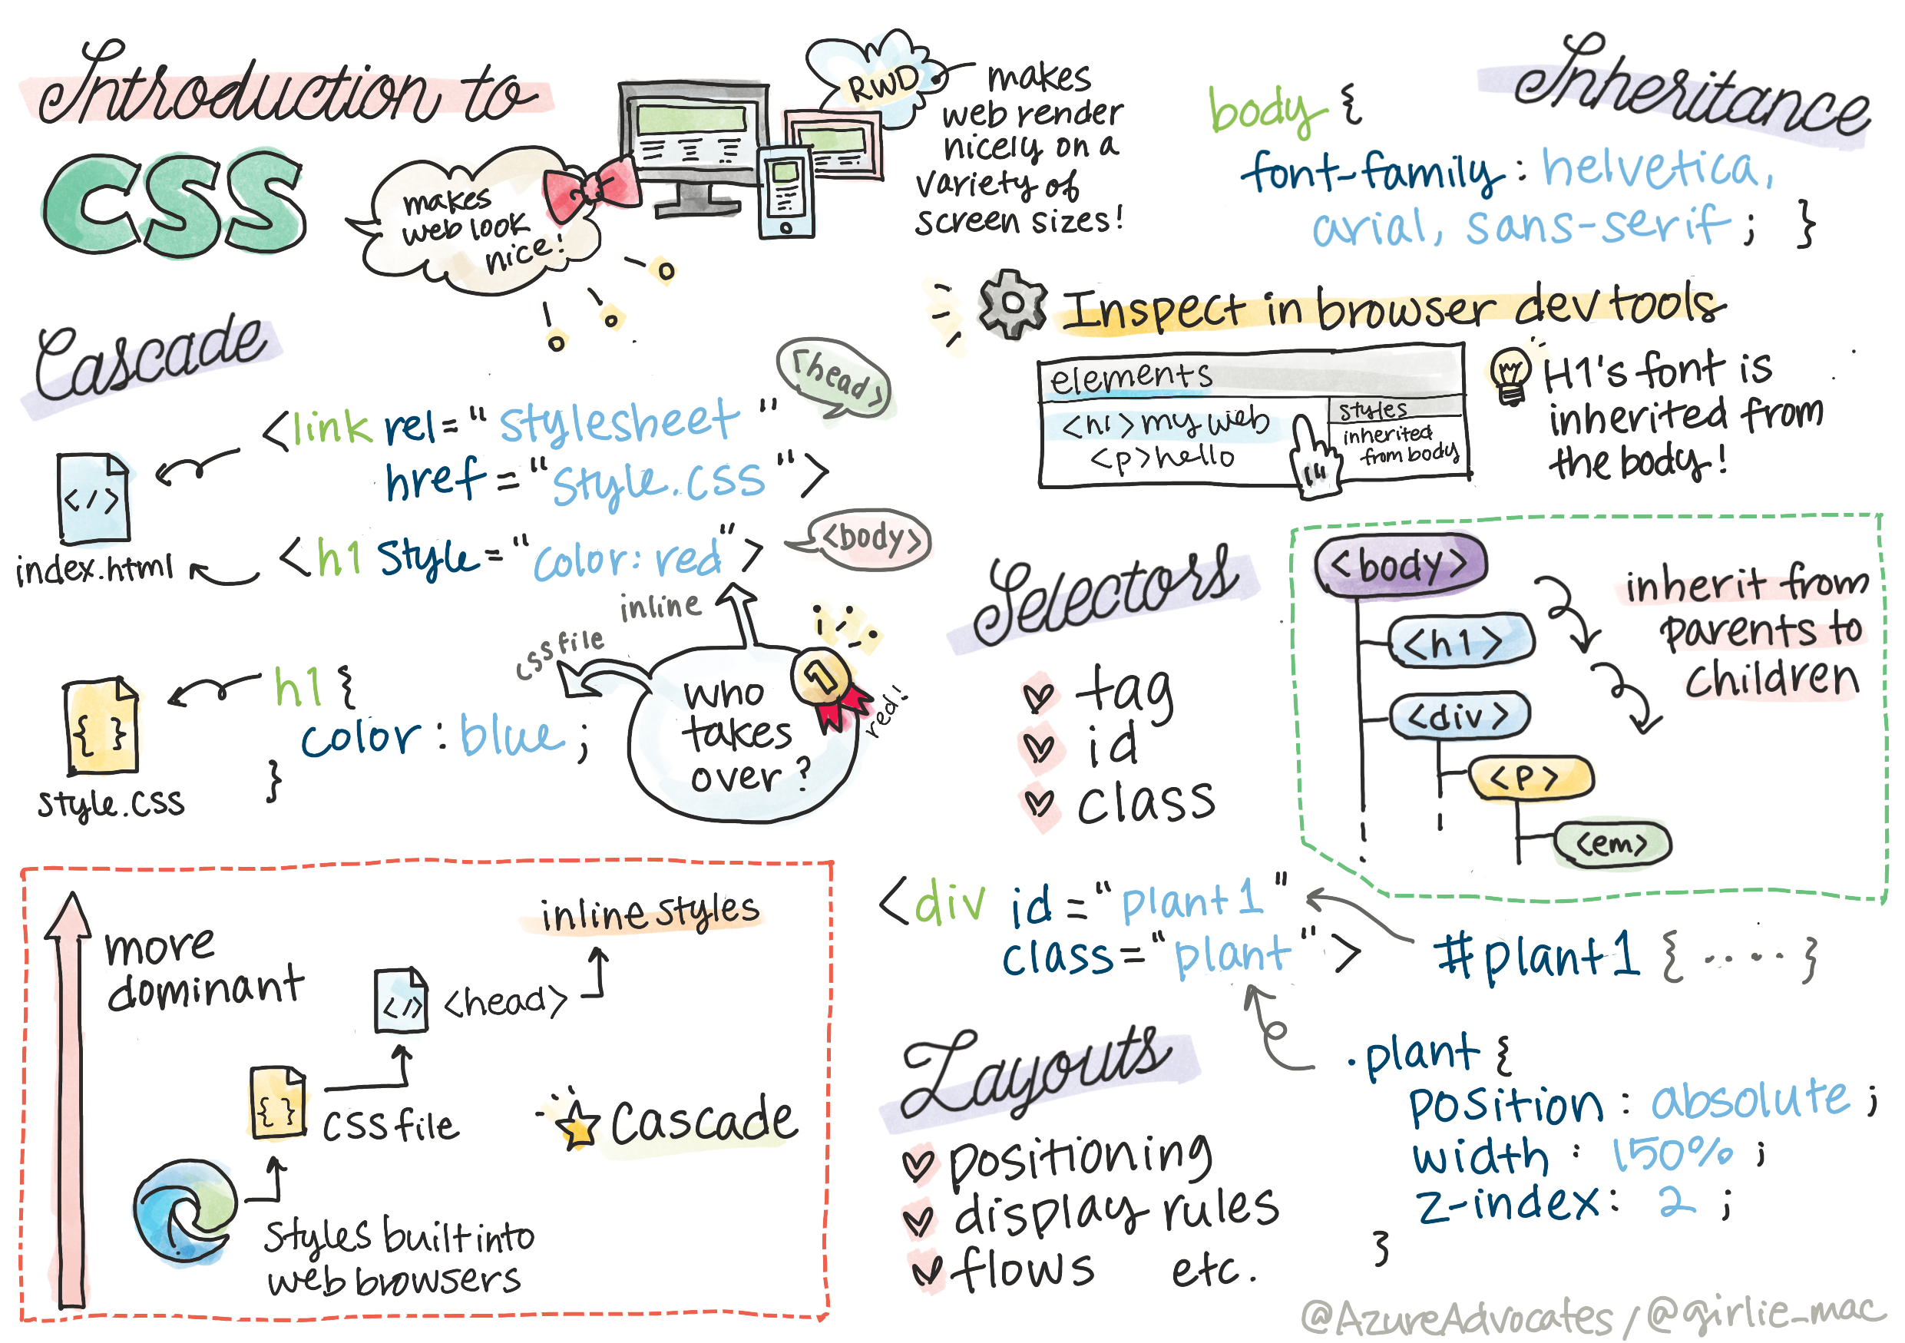

Slide 5


CSS stands for Cascading Style Sheets
CSS describes how HTML elements are to be displayed on screen, paper, or in other media i.e It is used to apply styles to HTML page.
CSS saves a lot of work. It can control the layout of multiple web pages all at once
Current Version of CSS is “CSS 3.x”.
CSS files can be saved by using “.css” extension.
Ex:- color , background , font-size, margin , padding …etc.

Slide 6

HOW TO APPLY CSS?

Slide 7

There are two ways to apply CSS to HTML file.
1)External CSS:-
i) It is used when the style is applied to many pages . With an external CSS , you can change the look of entire website by changing one file.
ii) <link> tag is used to link external CSS file.
2) Internal CSS:-
i)Internal CSS is used when single document has unique style.
ii) It can be applied by two ways by
a) using <style></style>tag.
b) using inline style attribute.

Slide 8
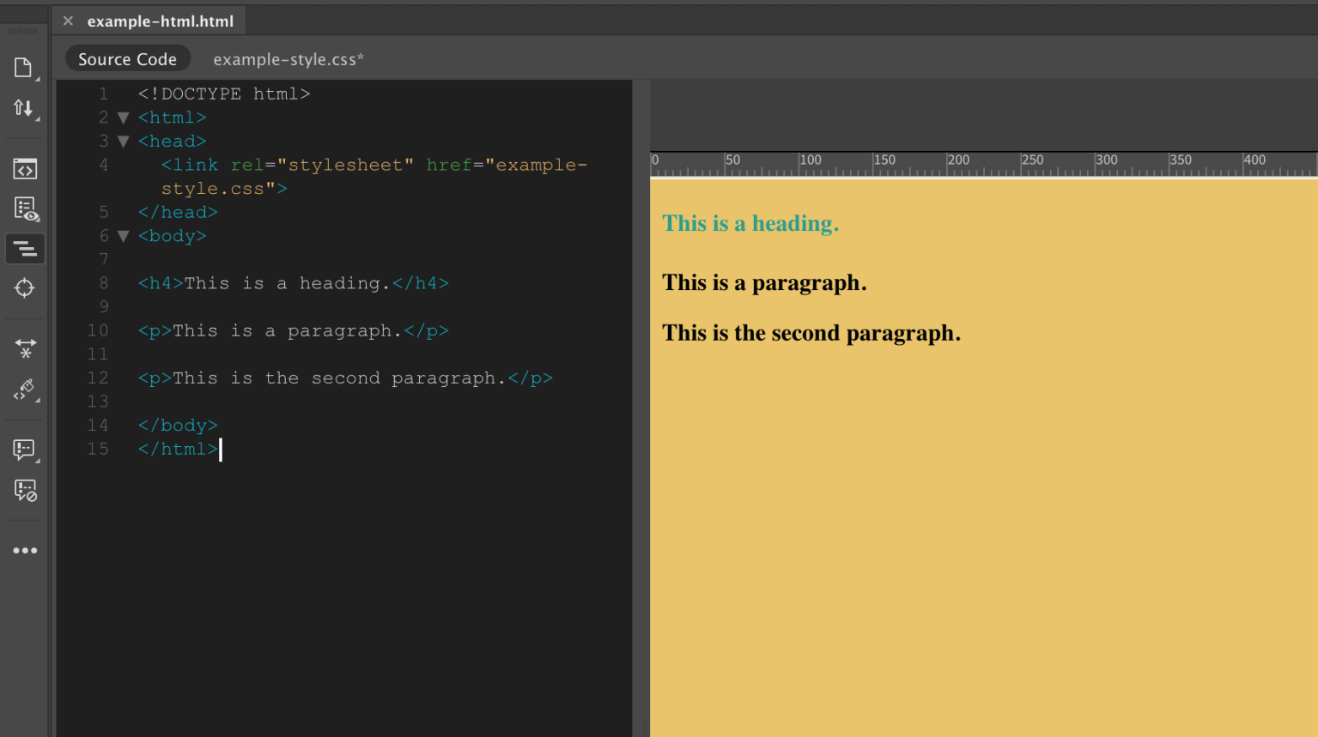
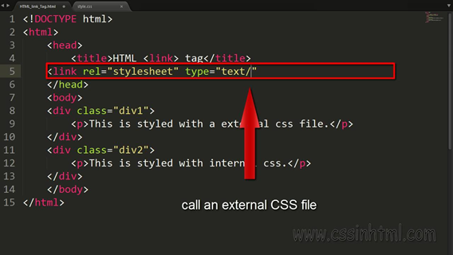
<!----------Through link tag------------>

Slide 9
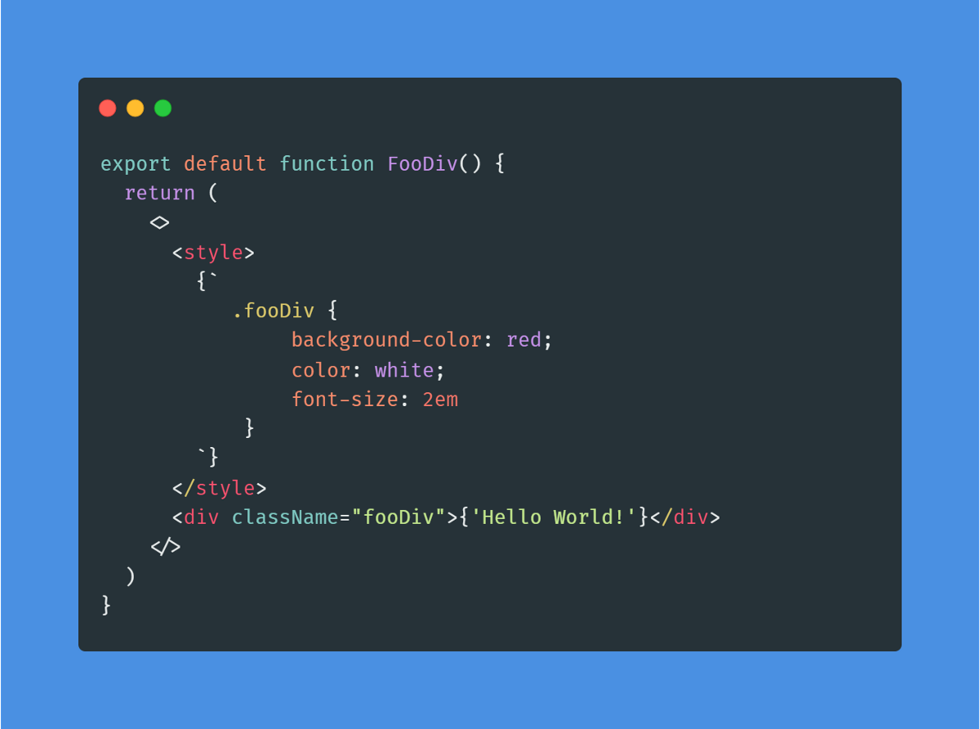
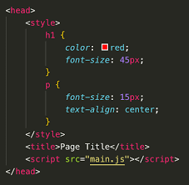
Through Style Tag

Slide 10
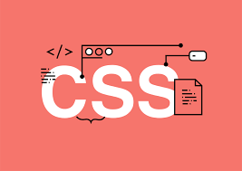
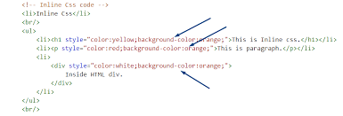
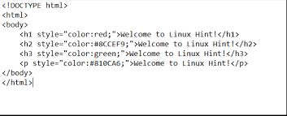
Through Inline style attribute

Slide 11


DIFFERENCES BETWEEN
EXTERNAL CSS
AND
INTERNAL CSS

Slide 12

External CSS | Internal CSS
<link> tag is used to link the external CSS file. | <style></style> tag or inline style attribute is used to apply internal CSS.
We can reuse External CSS in multiple files. | We cannot use Internal CSS in different files.
It has reusability. | It does not have reusability.
Ex:- <link rel=“stylesheet” href=“filename.css”> | Ex:- <style></style> <p style=“color:red;”></p>

Slide 13

Padding and Margin in CSS
Padding :- The Space around the content is called as Padding. ex:- padding=10px;
Margin :- The Space around the element is called as Margin. ex:- margin=10px;
Content
padding
margin
Content

Slide 14
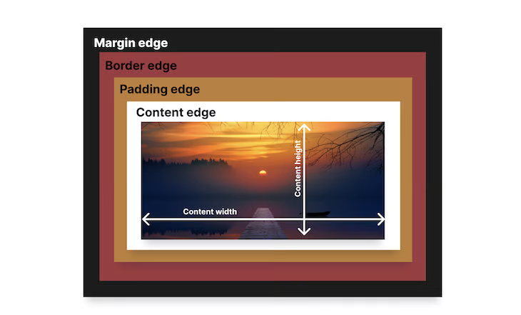
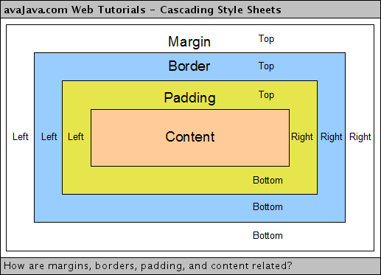
Box model in css
The combination of padding , border and margin is called as Box Model.

Slide 15


Slide 16


Difference between
ID selector
and
class selector

Slide 17


Difference between class and id selector?
Class selector | Id selector
It should start with Period (“ . ”). | It should start with Hash (“ # ”).
Class selector may be duplicate. | Id selector should be unique.
It has lesser priority (specificity) compared to id selector. | It has higher priority (specificity ) compared to class selector.
In a project with different teams / modules its suggestable to use class selector. | Its recommended to overcome domination of 3rd party CSS.
Ex:- .c1{ } | Ex:- #id1{ }

Slide 18

What is Z-index ?
Z-index property specifies the stack order of an element.
An element can have a positive or negative stack order.
It only works in positioned elements .i.e. absolute , relative, fixed , sticky.
Syntax:- z-index : number; (any)
Without z-index element defined last will be shown on the top.

Slide 19

Explain Dimensions in CSS ?
px :- It defines the property in terms of pixels .
pixel unit is an absolute unit to set width.(96px = 1In).
% :- It is used to set element size relative to the current size of the block/container.
em:- It is used to define element size relative to its font size.
rem:- It is used to define element size relative to font size of root element

